Slide 1

CSE- 207
Algorithms
Lecture: 10
Greedy Algorithms
Fahad Ahmed
Lecturer, Dept. of CSE
E-mail: fahadahmed@uap-bd.edu

Slide 2
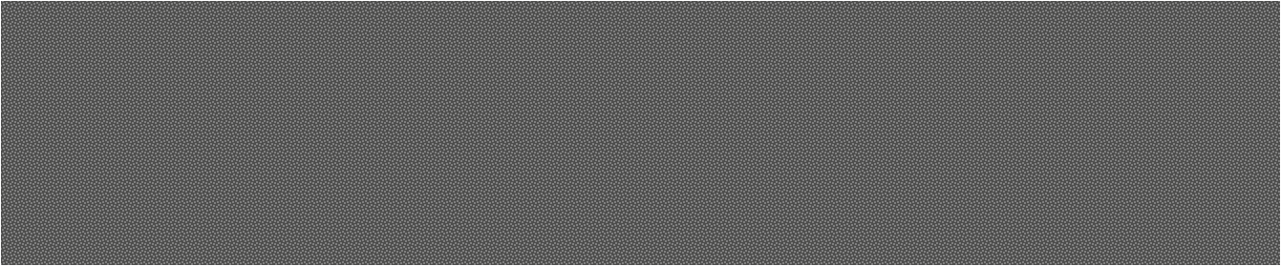
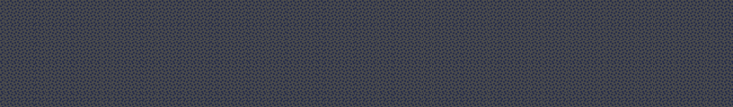
Knapsack problem

Slide 3
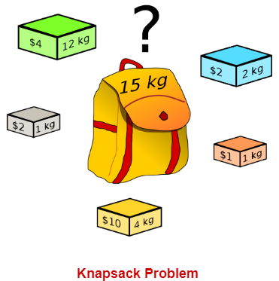
The Knapsack Problem
The famous knapsack problem:
A thief breaks into a museum. Fabulous paintings, sculptures, and jewels are everywhere. The thief has a good eye for the value of these objects, and knows that each will fetch hundreds or thousands of dollars on the clandestine art collector’s market.
But, the thief has only brought a single knapsack to the scene of the robbery, and can take away only what he can carry. What items should the thief take to maximize the haul?

Slide 4
Review: The Knapsack Problem
More formally, the 0-1 knapsack problem:
The thief must choose among n items, where the i-th item worth v_{i} dollars and weighs w_{i} pounds
Carrying at most W pounds, maximize value
Note: assume v_{i}, w_{i}, and W are all integers
“0-1” b/c each item must be taken or left in entirety
A variation, the fractional knapsack problem:
Thief can take fractions of items
Think of items in 0-1 problem as gold ingots, in fractional problem as buckets of gold dust

Slide 5
The Knapsack Problem: Applications
In many cases of resource allocation along with some constraint, the problem can be derived in a similar way of Knapsack problem.
Following is a set of example.
Finding the least wasteful way to cut raw materials
portfolio optimization
Cutting stock problems

Slide 6
Solving The Knapsack Problem
Both variations exhibit optimal substructure
The optimal solution to the fractional knapsack problem can be found with a greedy algorithm
How?
The optimal solution to the 0-1 problem cannot be found with the same greedy strategy
however, it can be solved with dynamic programming

Slide 7
O-1 knapsack is harder!
0-1 knapsack cannot be solved by the greedy strategy
Unable to fill the knapsack to capacity, and the empty space lowers the effective value per pound of the packing
We must compare the solution to the sub-problem in which the item is included with the solution to the sub-problem in which the item is excluded before we can make the choice
Dynamic Programming

Slide 8
knapsack problem
Here is the value per pound table.
Greedy choice – first take the item with most value per pound. So, take item 1 first, then item 2 and then item 3.
Item # | Value | Weight | Value/Weight
1 | 60 | 10 | 6
2 | 100 | 20 | 5
3 | 120 | 30 | 4
(most valuable)

Slide 9
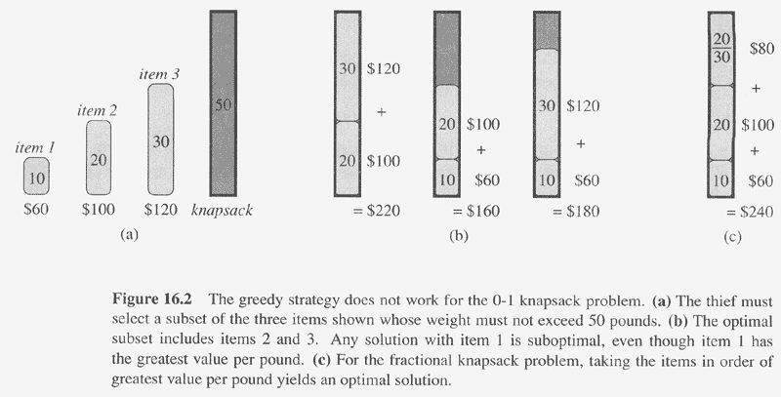

Slide 10
The Fractional Knapsack Problem
Given: A set S of n items, with each item i having
b_{i} - a positive benefit
w_{i} - a positive weight
Goal: Choose items with maximum total benefit but with weight at most W.
If we are allowed to take fractional amounts, then this is the fractional knapsack problem.
In this case, we let x_{i} denote the amount we take of item i
Objective: maximize
Constraint:

Slide 11
Greedy Algorithm for Fractional Knapsack problem
Fractional knapsack problem is solved using greedy method in the following steps-
Step-01:
For each item, compute its value / weight ratio.
Step-02:
Arrange all the items in decreasing order of their value / weight ratio.
Step-03:
Start putting the items into the knapsack beginning from the item with the highest ratio.
Put as many items as you can into the knapsack.

Slide 12
Example
A thief enters a house for robbing it. He can carry a maximal weight of 60 kg into his bag. There are 5 items in the house with the following weights and values.
What items should thief take if he can even take the fraction of any item with him?
Item | Weight | Value
1 | 5 | 30
2 | 10 | 40
3 | 15 | 45
4 | 22 | 77
5 | 25 | 90

Slide 13
Example
Step-01:
Compute the value / weight ratio for each item-
Items | Weight | Value | Ratio
1 | 5 | 30 | 6
2 | 10 | 40 | 4
3 | 15 | 45 | 3
4 | 22 | 77 | 3.5
5 | 25 | 90 | 3.6
Step-02:
Sort all the items in decreasing order of their value / weight ratio-
I-1 I-2 I-5 I-4 I-3
(6) (4) (3.6) (3.5) (3)

Slide 14
Example
Start filling the knapsack by putting the items into it one by one.
Knapsack Weight | Items in Knapsack | Cost
60 | Ø | 0
55 | I-1 | 30
45 | I-1, I-2 | 70
20 | I-1, I-2, I-5 | 160
Now,
Knapsack weight left to be filled is 20 kg but item-4 has a weight of 22 kg.
Since in fractional knapsack problem, even the fraction of any item can be taken.
So, knapsack will contain the following items-
< I-1 , I-2 , I-5 , (20/22) I4 >
Total cost of the knapsack
= 160 + (20/22) x 77
= 160 + 70
= 230 units
Items | Weight | Value | Ratio
1 | 5 | 30 | 6
2 | 10 | 40 | 4
3 | 15 | 45 | 3
4 | 22 | 77 | 3.5
5 | 25 | 90 | 3.6

Slide 15
Fractional Knapsack Algorithm - iterative
v → the set of values of items
w → the set of weights of items
c → capacity (weight need to be filled in) of the knapsack.
KS(c, v, w)
sort the item according to v/w in descending order and store in I
i =0, frac=1;
tVal=0;
n = I.length;
while (c>0 && i<n)
if(w[i]<=c) frac = 1;
else frac = c/w[i]
c = c – frac*w[i]
tVal += fract*v[i]
return tVal;
Running time complexity including sorting = O(nlogn)+O(n) = O(nlogn)
Running time complexity without sorting = O(n)

Slide 16
Fractional Knapsack Algorithm - recursive
I → sorted items according to v/w in descending order
c → capacity (weight need to be filled in) of the knapsack.
n → number of items
i→ current item
KS(c, I, i, n)
if (c<=0 or i>n) return 0;
if (c < I[i].weight)
frac = c/I[i].weight
return frac* I[i].value + KS(0, I, i+1, n)
else
return I[i].value + KS(c-I[i].weight, I, i+1, n)
Running time complexity including sorting = O(nlogn)+O(n) = O(nlogn)
Running time complexity without sorting = O(n)

Slide 17
Fractional Knapsack Algorithm
Time Complexity-
The main time taking step is the sorting of all items in decreasing order of their value / weight ratio.
If the items are already arranged in the required order, then while loop takes O(n) time.
The average time complexity of Sort is O(nlogn).
Therefore, total time taken including the sort is O(nlogn).

Slide 18
Coin changing problem

Slide 19
Coin Changing Problem
The coin changing problem is a known problem in the field of algorithms and a famous example in Greedy Algorithms which is one of the good ways for a making a good coin change.
The problem states that “given a set of coins with several values, it is required to make a change using those coins for a particular amount of cents using the minimum number of coins”.

Slide 20
Coin Changing Problem
Target value = 50
coins[] = {10,5,20,25}
Possible Solutions
{coin * count}
{5 * 10} = 50 [10 coins]
{5 * 8 + 10 * 1} = 50 [9 coins].
{10 * 5} = 50 [5 coins]
{20 * 2 + 10 * 1} = 50 [3 coins]
{20 * 2 + 5 * 2} = 50 [4 coins]
{25 * 2} = 50 [2 coins]
… … ….
Best Solution
Two 25 coins. Total coins two.
25 * 2 = 50

Slide 21
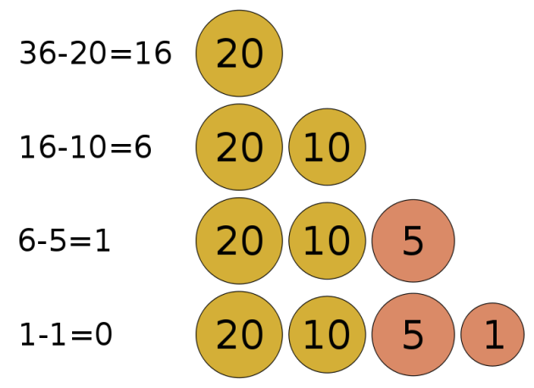
Coin Changing Problem
Target value n = 36
coins[] = {20,10,5,1}

Slide 22
Coin Changing Problem
Goal: Convert some amount of money n into given denominations, using the fewest possible number of coins
Input: An amount of money n, and an array of coins c = (c₁, c₂, …, c_{d})
Output: A list of d integers i₁, i₂, …, i_{d} such that c₁i₁ + c₂i₂ + … + c_{d}i_{d} = n
and i₁ + i₂ + … + i_{d} is minimal

Slide 23
Coin Changing Problem
Minimum Coin Change Problem Algorithm
1. Get coin array and a value.
2. Make sure that the array is sorted (descending order).
3. Take coin[i] as much we can.
4. Increment the count.
5. If solution found,
break it.
6. Otherwise,
follow step 3 with the next coin. coin[i+1].
4. Finally, print the count.
Running time complexity = O(n)
Running time complexity including sorting = O(mlogm)+O(n)

Slide 24
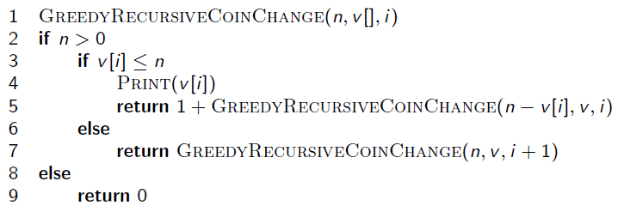
Coin Changing problem – recursive solution
n -> The change needed
v -> the list of coins sorted in descending order. So, the max value coin will be at first index, then the next smaller and so on. [O(mlogm)]
i -> index
Running time complexity = O(n)
Running time complexity including sorting = O(mlogm)+O(n)

Slide 25
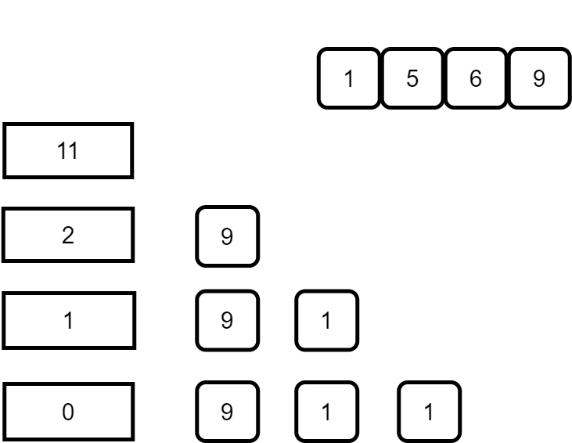
Issue with Greedy Algorithm Approach
While the coin change problem can be solved using Greedy algorithm, there are scenarios in which it does not produce an optimal result.

Slide 26
Issue with Greedy Algorithm Approach
Here, accordingly to the Greedy algorithm, we will end up the denomination 9, 1, 1 i.e. 3 coins to reach the value of 11. However, if you look closely, there is a more optimal solution. And that is by using the denominations 5 & 6. Using them, we can reach 11 with only 2 coins.
However, the way greedy approach works, this solution was never considered. And this can be thought of as a shortcoming of greedy approach. It does not work in the general cases.

Slide 27
Try the following
Case 1:
Make a change for 12 cents when you have only 4 kinds of coins : 10, 8, 4, and 1
Does it give you optimal solution?
Case 2:
You do not have the 5 cent coin. So, the coin set has 25 cent, 10 cent and 1 cent. Now give a change for 30 cent.
Does it give you optimal solution?
What can you conclude to?
Is greedy algorithm good for coin changing problem?

Slide 28
Another Example : Try yourself
K Centers Problem
Huffman Coding
Job Sequencing Problem
Kruskal’s Minimum Spanning Tree Algorithm
Prim’s Minimum Spanning Tree Algorithm
Dijkstra’s Shortest Path Algorithm

Slide 29


Slide 30
Divide and conquer | Greedy Algorithm
Divide and conquer is used to find the solution, it does not aim for the optimal solution. | A greedy algorithm is optimization technique. It tries to find an optimal solution from the set of feasible solutions.
DC approach divides the problem into small sub problems, each sub problem is solved independently and solutions of the smaller problems are combined to find the solution of the large problem. | In greedy approach, the optimal solution is obtained from a set of feasible solutions.
Sub problems are independent, so DC might solve same sub problem multiple time. | Greedy algorithm does not consider the previously solved instance again, thus it avoids the re-computation.
DC approach is recursive in nature, so it is slower and inefficient. | Greedy algorithms are iterative in nature and hence faster.
Divide and conquer algorithms mostly runs in polynomial time | Greedy algorithms also run in polynomial time but takes less time than Divide and conquer
Examples: Merge sort, Quick sort, Binary search, Strassen’s matrix multiplication, convex hull problem, large integer problem, exponential problem | Examples: Knapsack problem, Activity selection problem, Job scheduling problem, Huffman codes, Optimal storage on tapes, Optimal merge pattern.

Slide 31
So, we can't guarantee that the
Greedy algorithm always produces the overall best result.

Slide 32
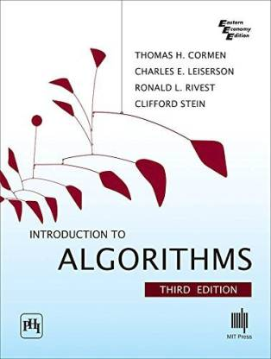
Reference
Chapter 16
Introduction to Algorithms, 3rd Edition Thomas H. Cormen
https://www.geeksforgeeks.org/fundamentals-of-algorithms/?ref=shm
https://www.codesdope.com/course/algorithms-greedy-algorithm/

Slide 33

Thanks to All

